Slide 1



Boom Bikes
Linear Regression Case Study

Slide 2
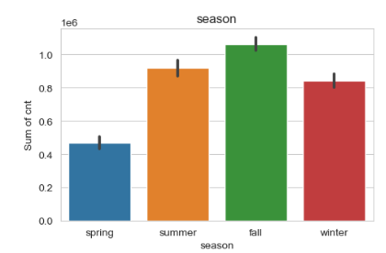
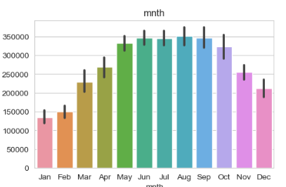
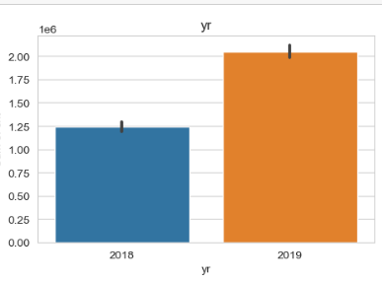
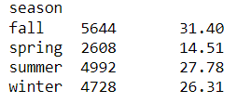
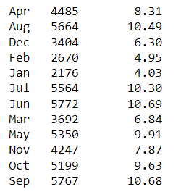

Assignment-based Subjective Questions
1. From your analysis of the categorical variables from the dataset, what could you infer about their effect on the dependent variable? (3 marks)
Here is the inference about the effect of categorical columns on the dependent variable :
Max Rides are from the fall Season
Rides have increased year on year
Rides growth visible till June and after that it started declining,
Peak are between May to Sep.

Slide 3
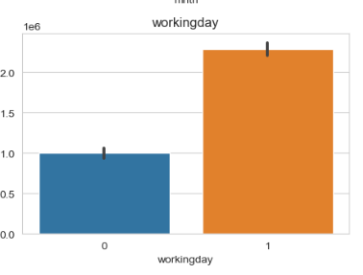
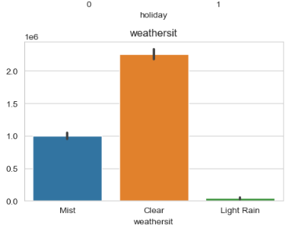
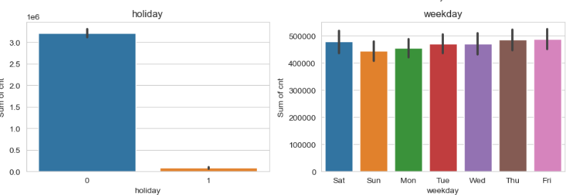
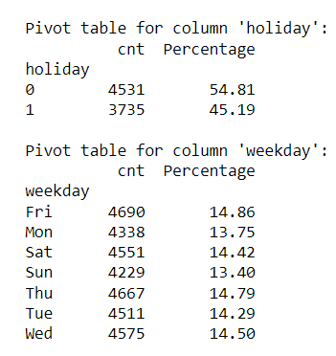

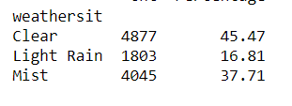
Assignment-based Subjective Questions
No Major Impact on holiday and weekday
Working days have higher ride counts
Clear Weather Situation have higher Rides

Slide 4
Assignment-based Subjective Questions
2. Why is it important to use drop_first=True during dummy variable creation?
When we apply dummy variable technique to a variable , it basically convert all the characters to True/ False (Abbreviated as 0,1 ). If value of a row is true that means the other variable can be considered as false itself. Having that column will add an extra space which can be very well interpreted even without its presence , so it drops the first column.
For Example : Lets say we have a column as Weather condition which has three distinct values : clear , light rain , ,mist. The same will be represented as below :
Clear | Light Rain | Mist | Represents
0 | 1 | 0 | Light Rain
0 | 0 | 1 | Mist
1 | 0 | 0 | Clear
Light Rain | Mist | Represents
1 | 0 | Light Rain
0 | 1 | Mist
0 | 0 | Clear
Same can be
Achieved With
Just 2 Columns

Slide 5
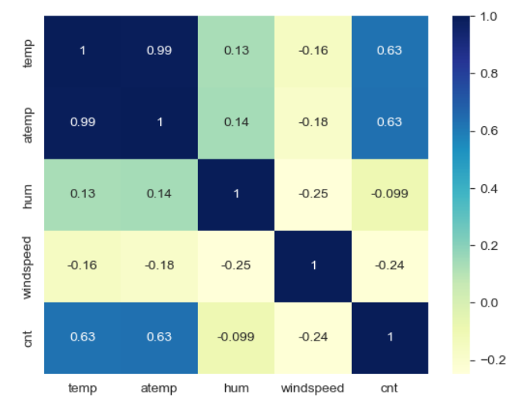
Assignment-based Subjective Questions
3. Looking at the pair-plot among the numerical variables, which one has the highest correlation with the target variable?
Temp and Atemp variable have the
Highest correlation with the target variable

Slide 6
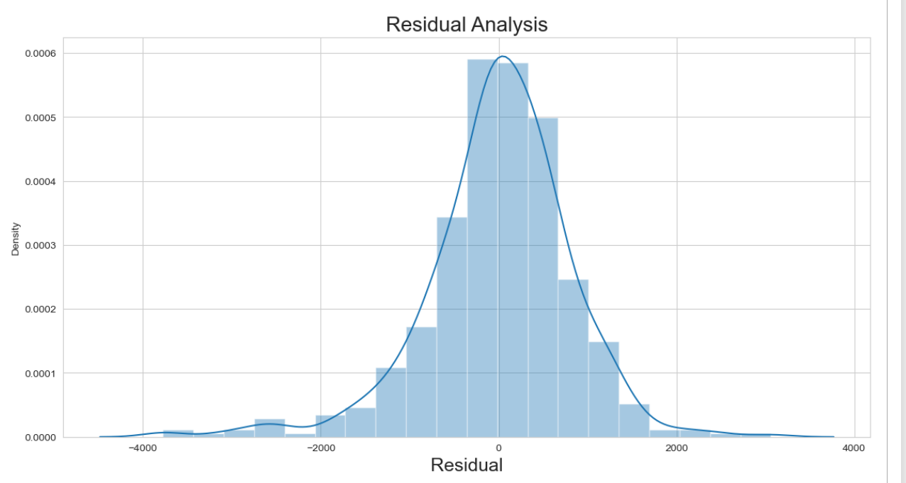
Assignment-based Subjective Questions
4. How did you validate the assumptions of Linear Regression after building the model on the training set?
In linear regression, the assumption of normally distributed residuals is crucial for valid hypothesis testing, confidence intervals, and model inference. In our case , we calculated the residual error , By plotting it , we found it to be normally distributed

Slide 7
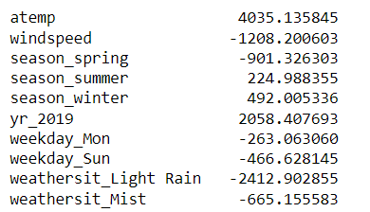
Assignment-based Subjective Questions
5. Based on the final model, which are the top 3 features contributing significantly towards explaining the demand of the shared bikes?
The top 3 Features that contribute significantly are :
Atemp – High Ride as Feeling Temperature rises
Yr_2019 – High Count of Rides As the year increase
Weathersit_Light Rain – Low Rides With Light Rain

Slide 8
General Subjective Questions
1. Explain the linear regression algorithm in detail.
Linear Regression Algorithm is a supervised algorithm which is used to predict a continuous target variable based on single or multiple independent variable. If it is a single independent variable , it is known as simple linear regression and if it is more than 1 , it is referred as multiple linear regression.
Linear Regression is only possible when there is a linear relation found between different variables (also referred as features) , if there is no linear relation is visible on a plotted scatter chart of different variables , the model will not work as expected and the accuracy of model will get down drastically. Linear regression assumes linearity, independence of errors, constant variance (homoscedasticity), normality of errors, and absence of multicollinearity between independent variables. These assumptions should be verified and validated.
Linear regression equation is referred as Y = β0 + β1X1 + β2 x X2 + β3 x X3 ... βn x βn where n is the number of independent variable. This equation is basically the best fit line equation that has the least distance between actual and predicted values of the target variable. While establishing , this equation and during the process of Feature selection , it is very important to make sure that the selected features for the model creation should not have multicollinearity issue between them because if they have multicollinearity , the weightage of similar feature will be taken into account making our model accuracy not as expected.

Slide 9
General Subjective Questions
1. Explain the Anscombe’s quartet in detail.

